Slide 1
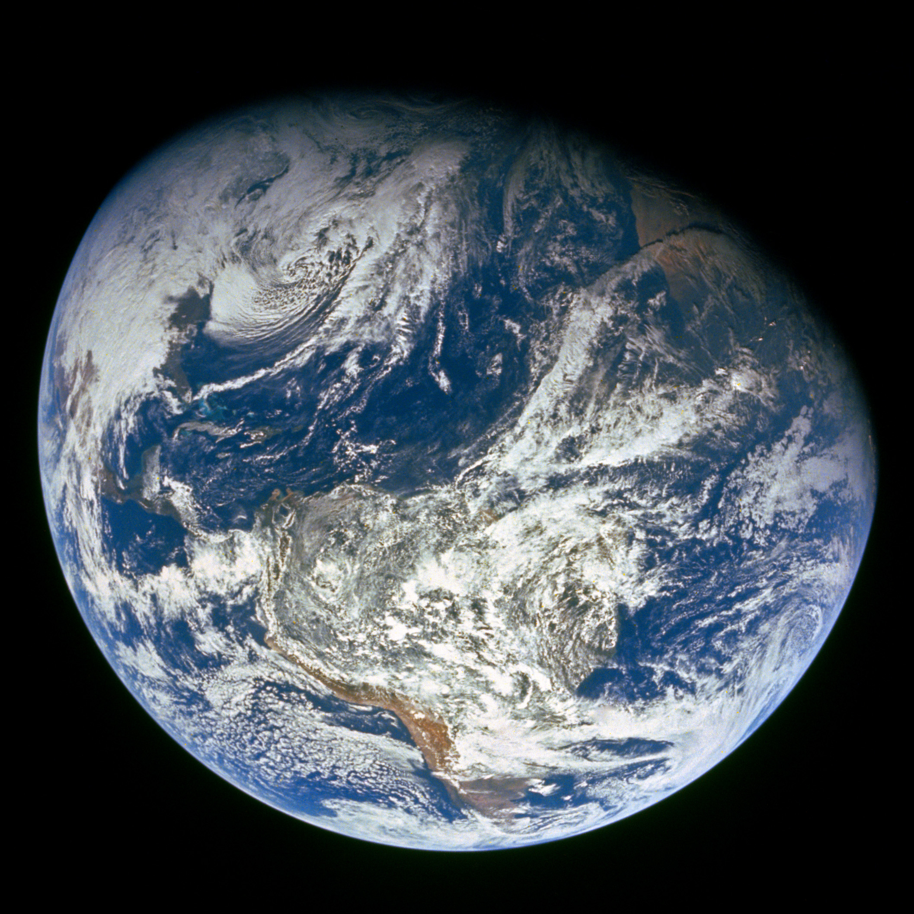
GENESIS
”In the beginning God…”

Slide 2
Review
God promises to make Abraham a great nation and a blessing to all families of the earth. Abraham leaves his home in Ur for a land that God would show him. Genesis 12:1-3
Abraham travels from Ur, to Haran, and then to Canaan. Near Bethel and Ai, Abraham and Lot part ways. Abraham dwells in Canaan, Lot in the cities of the plain. Genesis 13:12
Lot is captured, Abraham rescues him, then Abraham meets Melchizedek (king and priest) who blesses him. Genesis 14:18-20
God repeats his land promise to Abraham, but tells him that his descendants will be strangers in a land for 400 years. Genesis 15:13-16
Sarah gives her handmaid Hagar to Abraham for a wife. Hagar bears a son named Ishmael. Genesis 16:3
When Abraham is 99, God promises Sarah a son named Isaac, and God’s covenant is with him. But Ishmael will also become a great nation. Genesis 17:19-21

Slide 3
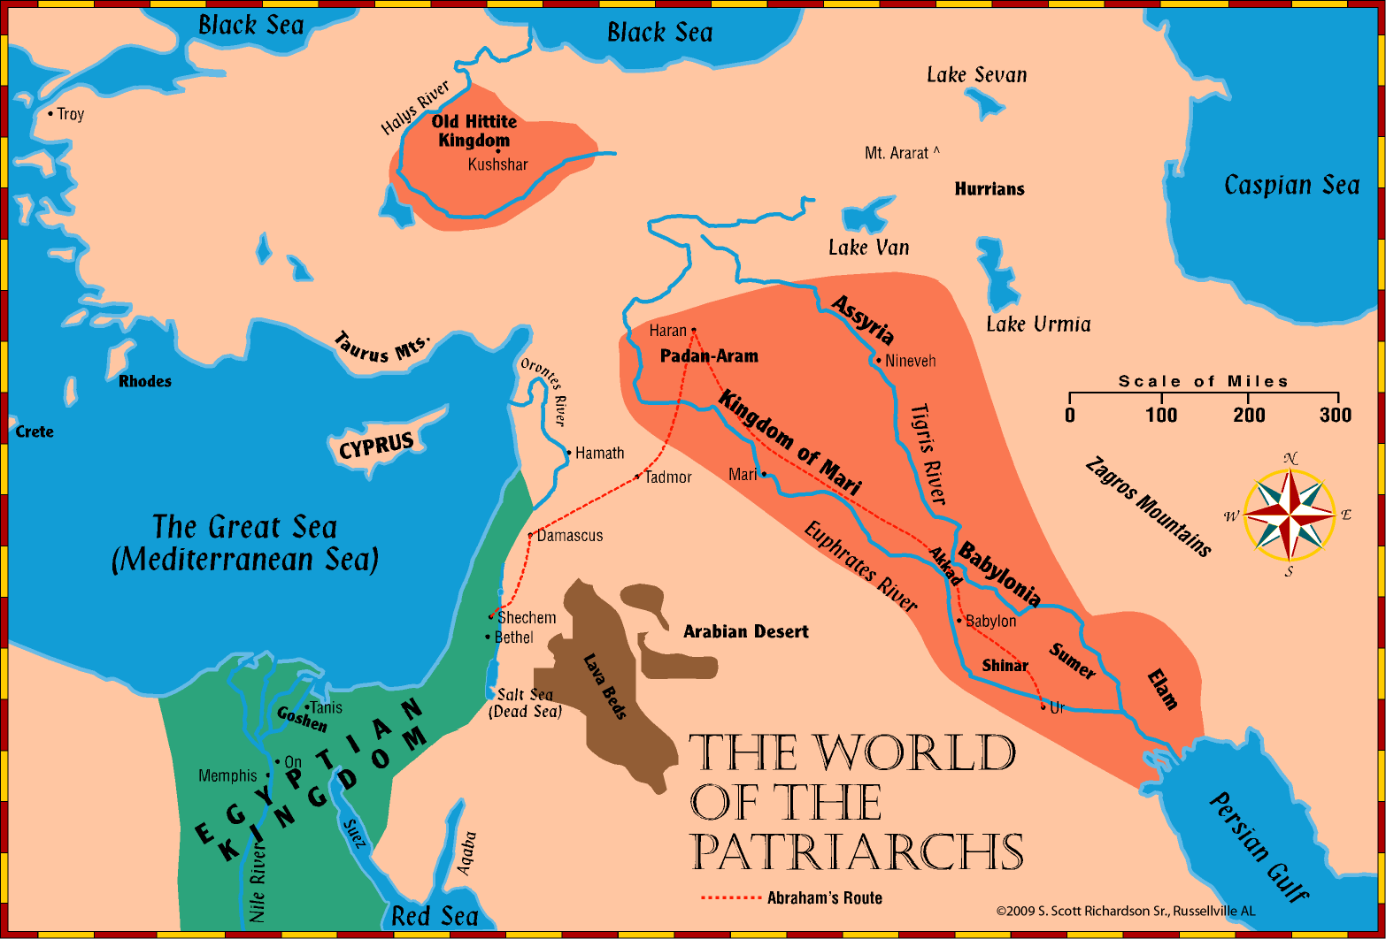

Slide 4
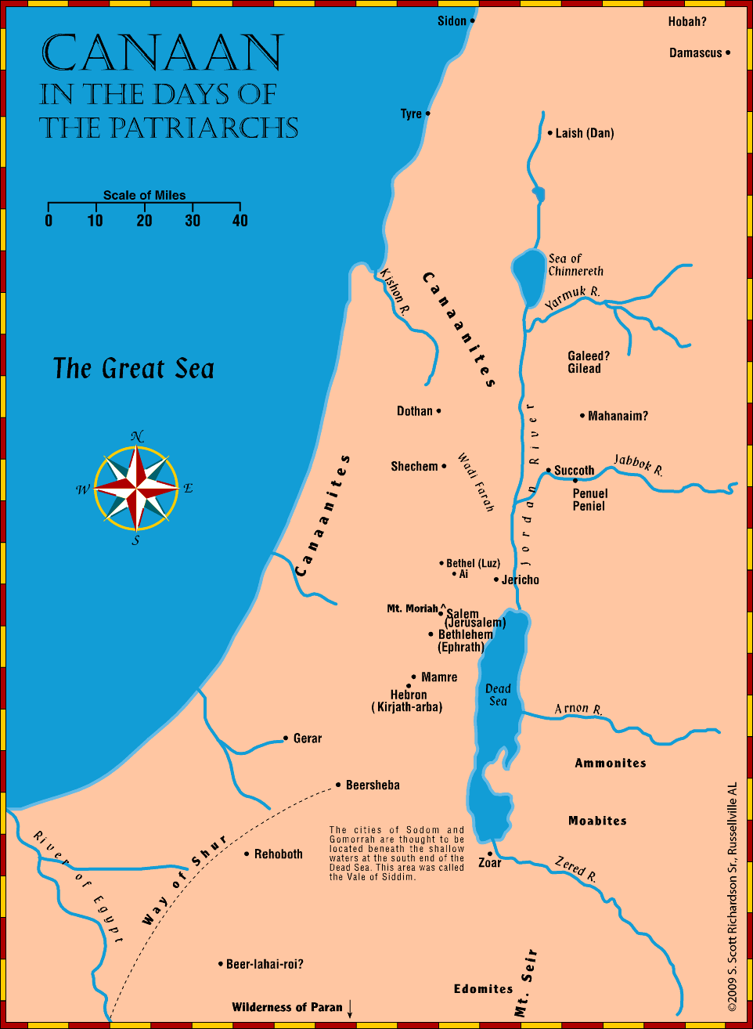

Slide 5
Overview of Our Study Genesis 18 - 19
Abraham and Lot are examples of those who “entertained angels unaware” Hebrews 13:2
Angels appear to Abraham and Sarah and promise them a son. They tell of the coming destruction to Sodom and Gomorrah. Abraham entreats God to spare them if 10 righteous can be found.
Angels appear to Lot. While they lodge with Lot, the men of the Sodom accost Lot and demand that the visitors be given to them. The angels show mercy to Lot and his family and bring them out of the city. God destroys the wicked cities. Moab and Ammon are born of Lot.

Slide 6
Three Men Visit Abraham Genesis 18:1-15
Abraham and Sarah prepare food for the visitors Genesis 18:1-8
[Hebrews 13:2 KJV] 2 Be not forgetful to entertain strangers: for thereby some have entertained angels unawares.
The Lord promises Sarah a child Genesis 18:9-15
The Lord would return to her at the time of life (ESV – about this time next year)
Sarah laughs now in disbelief, but later with Joy Genesis 21:6-7
Is anything too hard for the Lord? If God can speak matter into existence from nothing, and breathe life into that matter, can he not manipulate that same matter that he created and animated?

Slide 7
Abraham Intercedes for Sodom Genesis 18:16-33
The men leave Abraham to visit Sodom Genesis 18:16-22
The Lord desires to reveal to Abraham his plan to destroy Sodom. The Lord says, 1) Abraham will surely become a great nation, and 2) all the nations of the earth will be blessed in him, and 3) I know that he will command his children to keep my way (or, I’ve chosen him to command his children to keep my way, ESV) – that I may bless him. Is God’s point that he wants Abraham to be able to use God’s judgment against these cities as a means to teach his children – just as Peter and Jude use it as an example to us of God’s vengeance (2 Peter 2:6; Jude 3-7)? God chose Abraham to command his children – so that he could bless him.

Slide 8
Abraham Intercedes for Sodom Genesis 18:16-33
Abraham entreats God on behalf of Sodom. Would God spare the city for the sake of the righteous there? For 50, 45, 40, 30, 20 or 10? Genesis 18:23-33
”Shall not the judge of all the earth do right” (Genesis 18:15) Man is evil, God is good – and his judgments are always right. Never think to accuse God of doing wrong in your life. By design, this world is temporary – it is not meant to be heaven.
[2Peter 3:11-15 KJV] 11 [Seeing] then [that] all these things shall be dissolved, what manner [of persons] ought ye to be in [all] holy conversation and godliness, 12 Looking for and hasting unto the coming of the day of God, wherein the heavens being on fire shall be dissolved, and the elements shall melt with fervent heat? 13 Nevertheless we, according to his promise, look for new heavens and a new earth, wherein dwelleth righteousness. 14 Wherefore, beloved, seeing that ye look for such things, be diligent that ye may be found of him in peace, without spot, and blameless. 15 And account [that] the longsuffering of our Lord [is] salvation; even as our beloved brother Paul also according to the wisdom given unto him hath written unto you;

Slide 9
Sodom and Gomorrah are Destroyed Genesis 19:1-29
Lot entreats the angels to lodge with him Genesis 19:1-3
The men of the city accost Lot for the visitors Genesis 19:4-11

Slide 10
Sodom and Gomorrah are Destroyed Genesis 19:1-29
The angels lead Lot out and instruct him to flee Genesis 19:12-22
Take any he has out of the city. His sons-in-law think he is joking
The angels show mercy to Lot and lead them out
They cannot do anything until Lot reaches his destination
God overthrows the cities and all the plain Genesis 19:23-29
Remember Lot’s wife – don’t think about what you are leaving behind (Luke 17:22-37 / Matthew 24:15-18)

Slide 11
Sodom and ”righteous Lot”
[2Peter 2:6-9 KJV] 6 And turning the cities of Sodom and Gomorrha into ashes condemned [them] with an overthrow, making [them] an ensample unto those that after should live ungodly; 7 And delivered just Lot, vexed with the filthy conversation of the wicked: 8 (For that righteous man dwelling among them, in seeing and hearing, vexed [his] righteous soul from day to day with [their] unlawful deeds;) 9 The Lord knoweth how to deliver the godly out of temptations, and to reserve the unjust unto the day of judgment to be punished:
Just Lot
That righteous man
Vexed with their filthy lives

Slide 12
Sodom’s Sin
[Jude 1:7 KJV] 7 Even as Sodom and Gomorrha, and the cities about them in like manner, giving themselves over to fornication, and going after strange flesh (unnatural desire – ESV), are set forth for an example, suffering the vengeance of eternal fire.
Fornication
Going after strange flesh (unnatural desire) Romans 1:26-27 “men with men” -> against nature
Yes, the destruction of Sodom is “in the Old Testament” – but the New Testament agrees that they were wrong, describes why, and holds them up as an example of God’s vengeance – and something to contend against (Jude 3).

Slide 13
The daughters of Lot bear Moab and Ammon Genesis 19:30-38
In their mind, “no one left” Genesis 19:31
In connection with Lot
[Deuteronomy 2:9, 19 KJV] 9 And the LORD said unto me, Distress not the Moabites, neither contend with them in battle: for I will not give thee of their land [for] a possession; because I have given Ar unto the children of Lot [for] a possession. ...
19 And [when] thou comest nigh over against the children of Ammon, distress them not, nor meddle with them: for I will not give thee of the land of the children of Ammon [any] possession; because I have given it unto the children of Lot [for] a possession.

Slide 14
Summary and Application
Both Abraham and Lot are gracious in hospitality – “forget not to entertain strangers…” Hebrews 13:2
Nothing is too hard for the Lord (Genesis 18:14, 17:17). God’s creation is at the mercy of his will – God’s promises are not dependent on our perception of plausibility.
God’s destruction of the wicked in Sodom and Gomorrah are an example against those who live ungodly 2 Peter 2:6

Slide 15
Sodom
[Matthew 11:20-24 KJV] 20 Then began he to upbraid the cities wherein most of his mighty works were done, because they repented not: 21 Woe unto thee, Chorazin! woe unto thee, Bethsaida! for if the mighty works, which were done in you, had been done in Tyre and Sidon, they would have repented long ago in sackcloth and ashes. 22 But I say unto you, It shall be more tolerable for Tyre and Sidon at the day of judgment, than for you. 23 And thou, Capernaum, which art exalted unto heaven, shalt be brought down to hell: for if the mighty works, which have been done in thee, had been done in Sodom, it would have remained until this day. 24 But I say unto you, That it shall be more tolerable for the land of Sodom in the day of judgment, than for thee.

